Slide 1
Instructions for the Process of Identifying Literature References

Slide 2
eLIBRARY.ru offers a convenient service for searching and identifying Literature references based on a provided list. To use this service, you should: 1. Log in to the website https://elibrary.ru

Slide 3
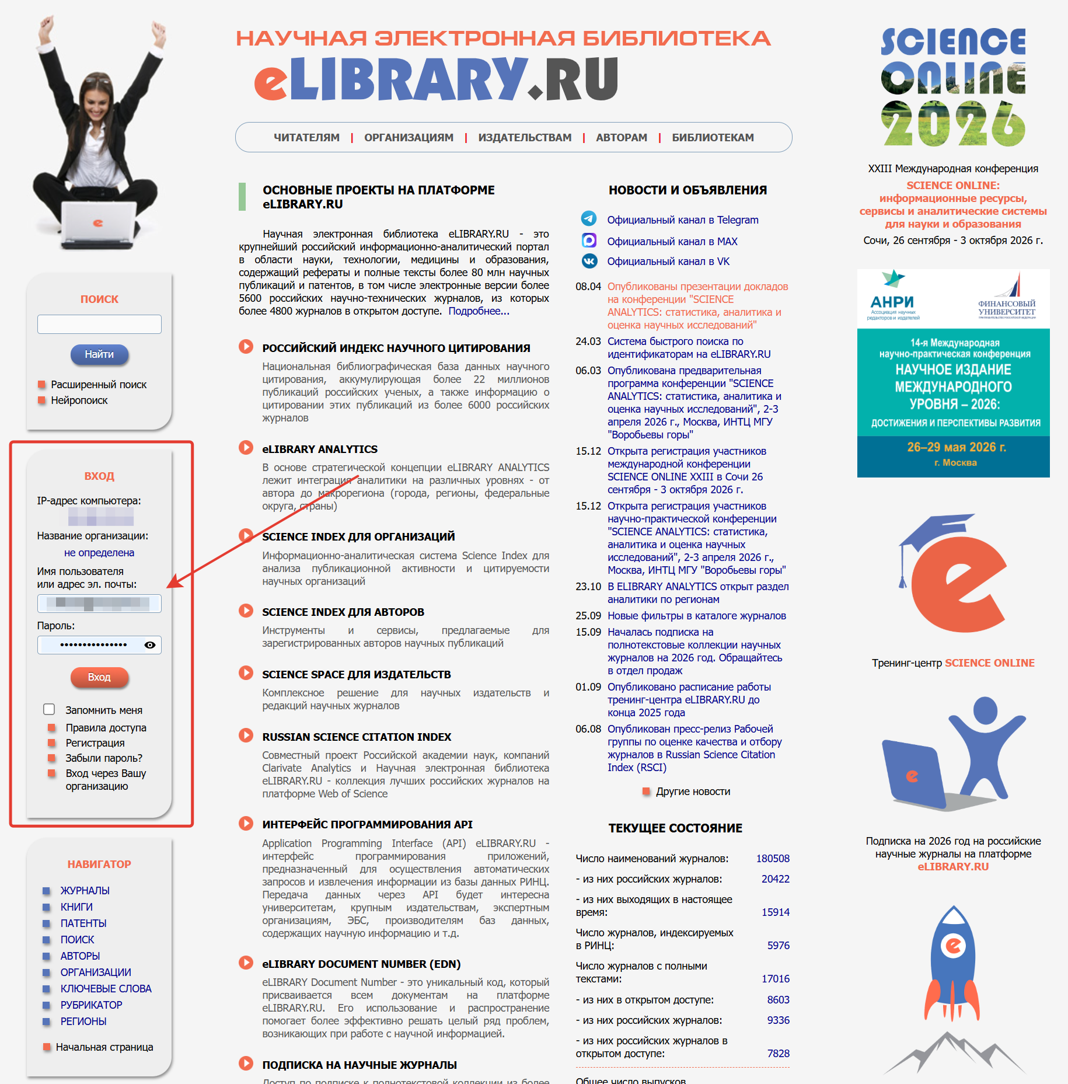

Slide 4
If you are not registered on https://elibrary.ru,you should complete the registration form here: link

Slide 5
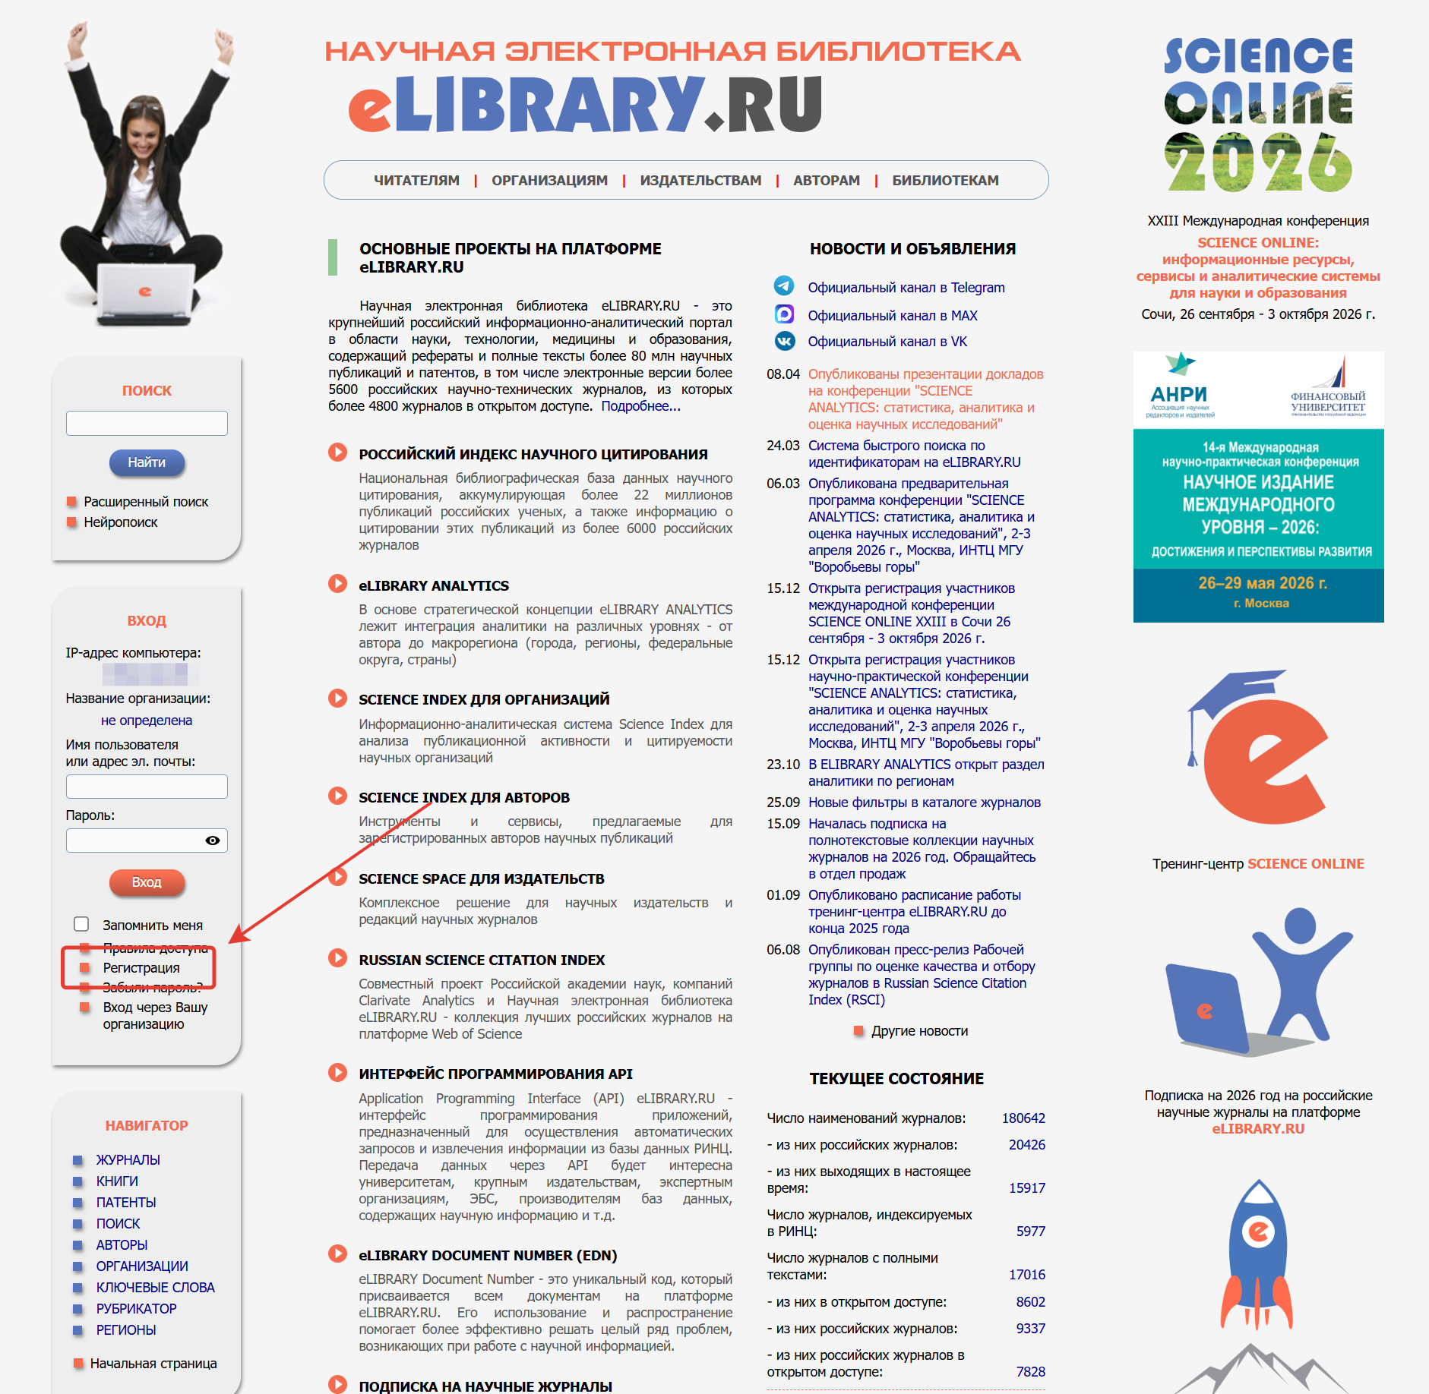

Slide 6
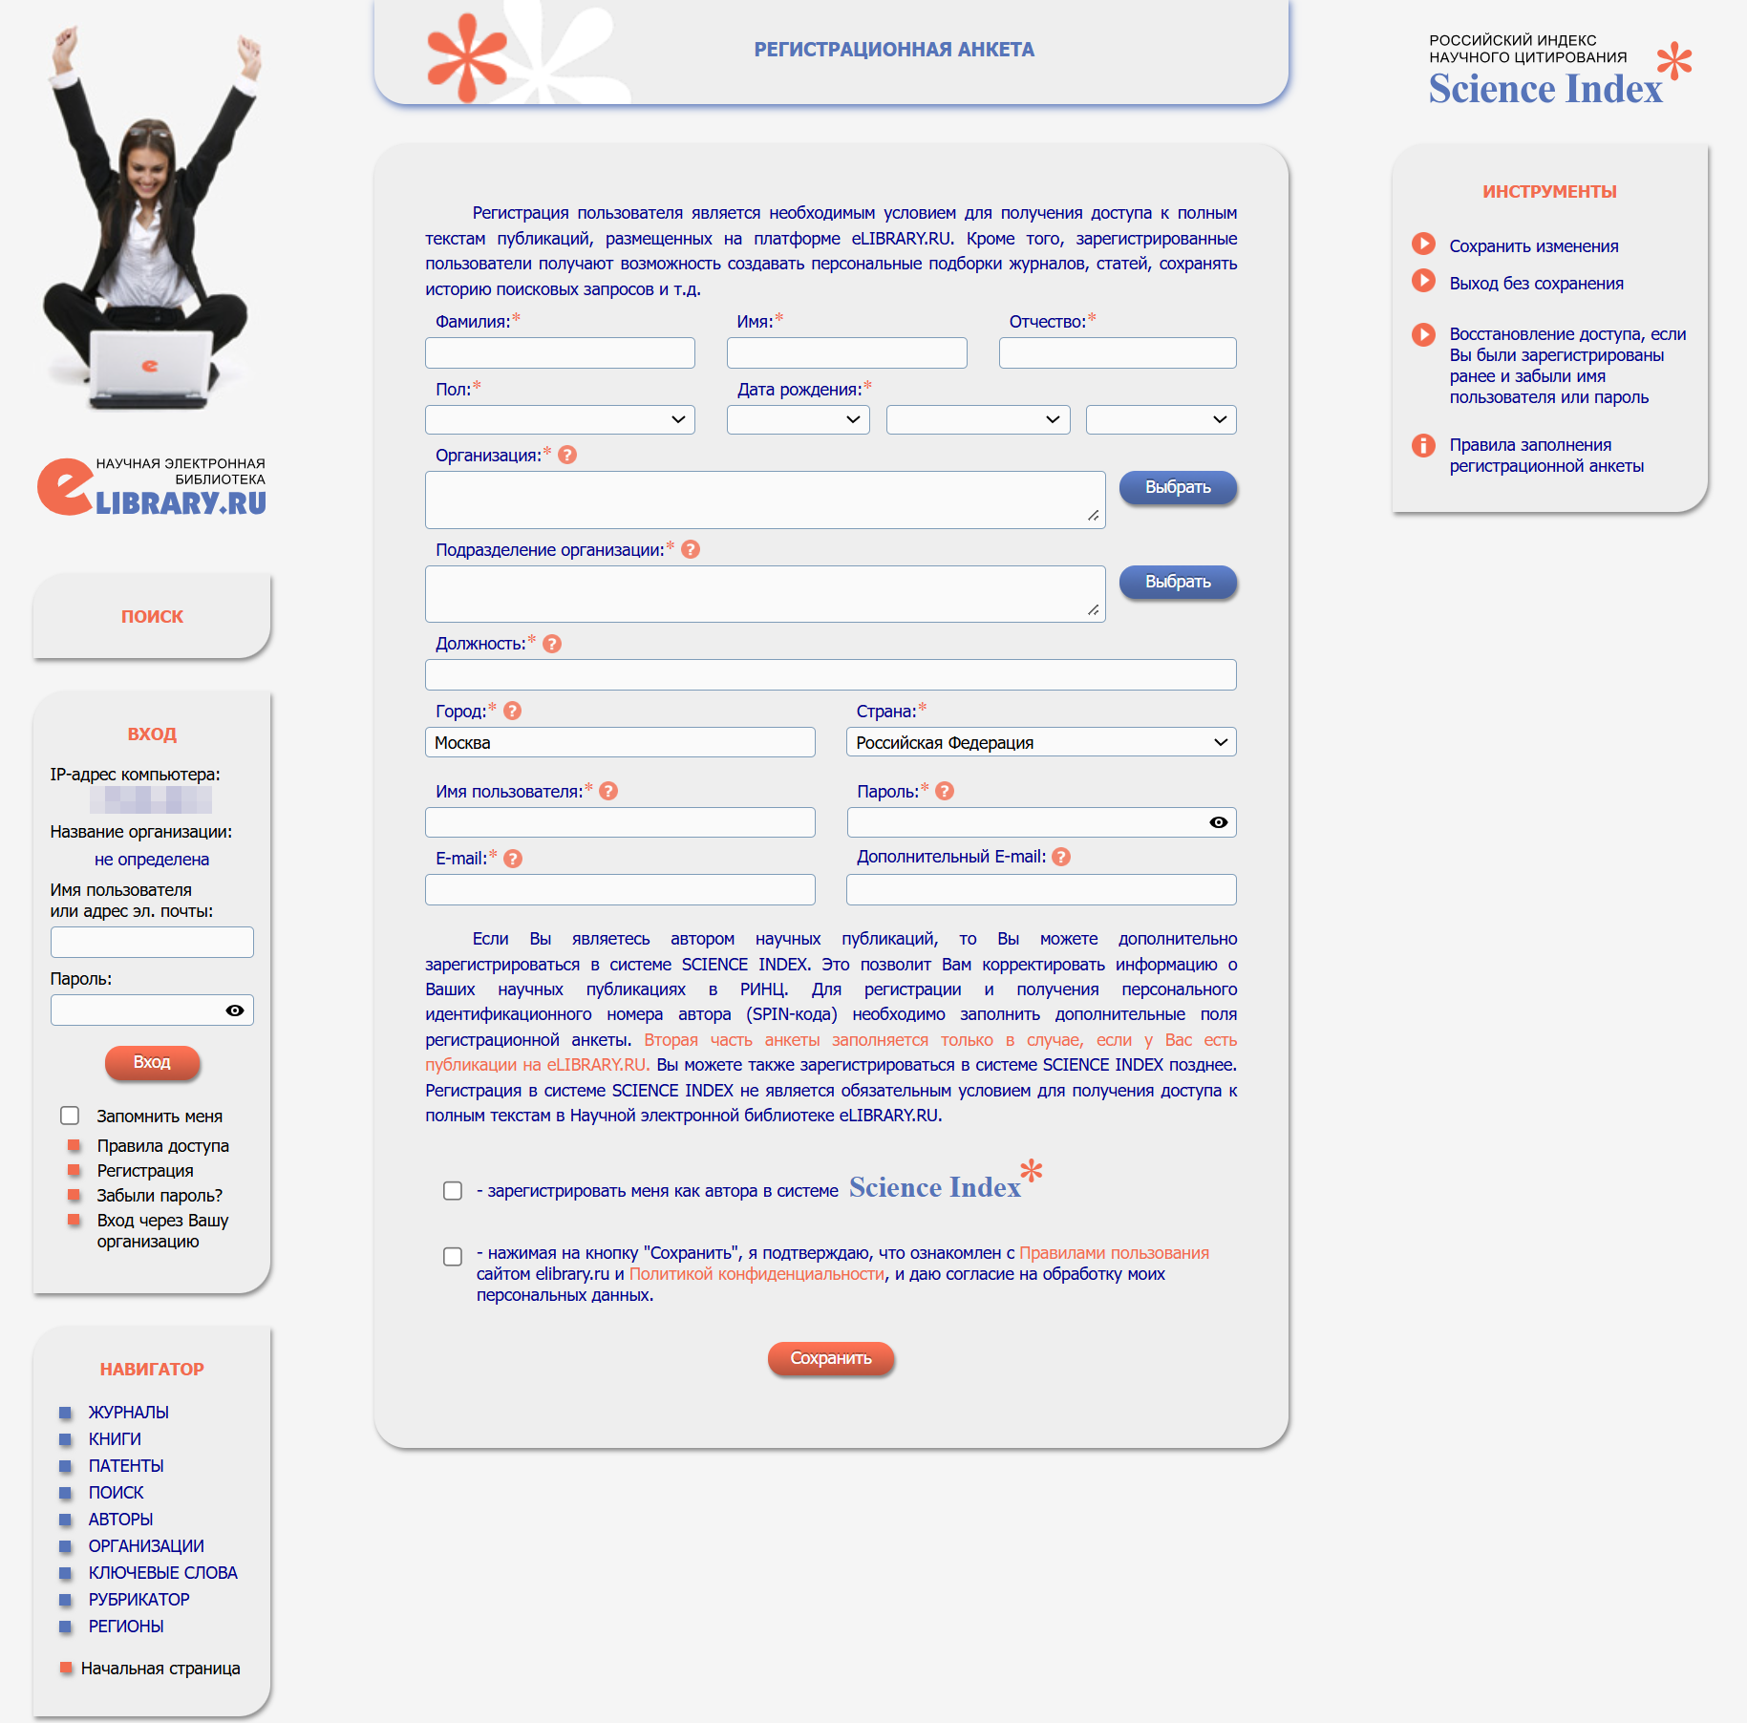

Slide 7
After completing the authorization, find EDN sticker in the green field and switch to this section

Slide 8
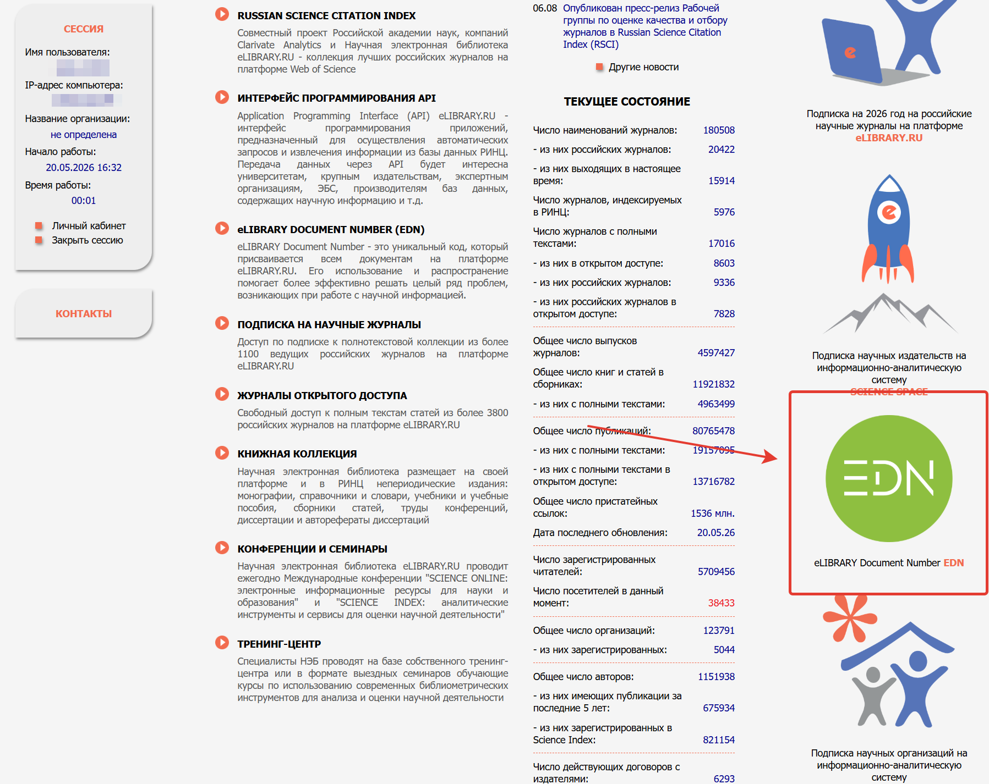

Slide 9
Our next objetive is “Service for automatic identification of links in the reference list”

Slide 10
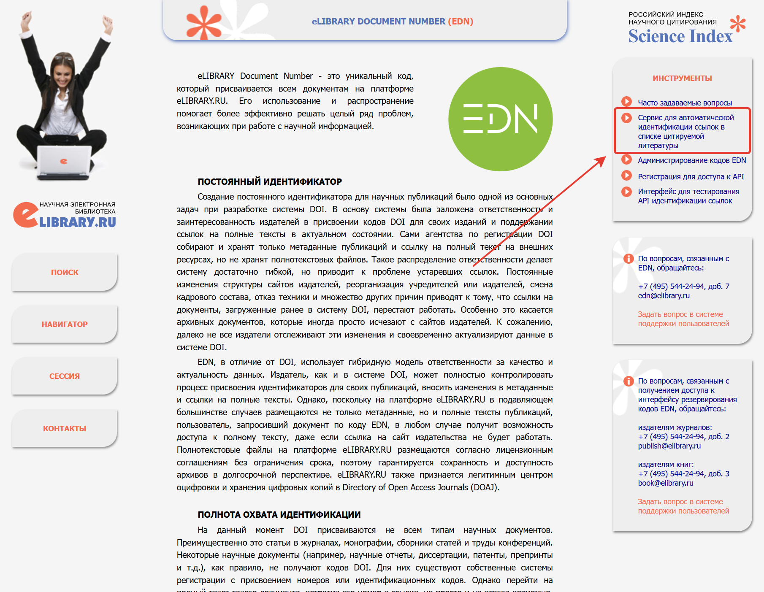

Slide 11
Here you will find a field for entering an existing reference list.

Slide 12
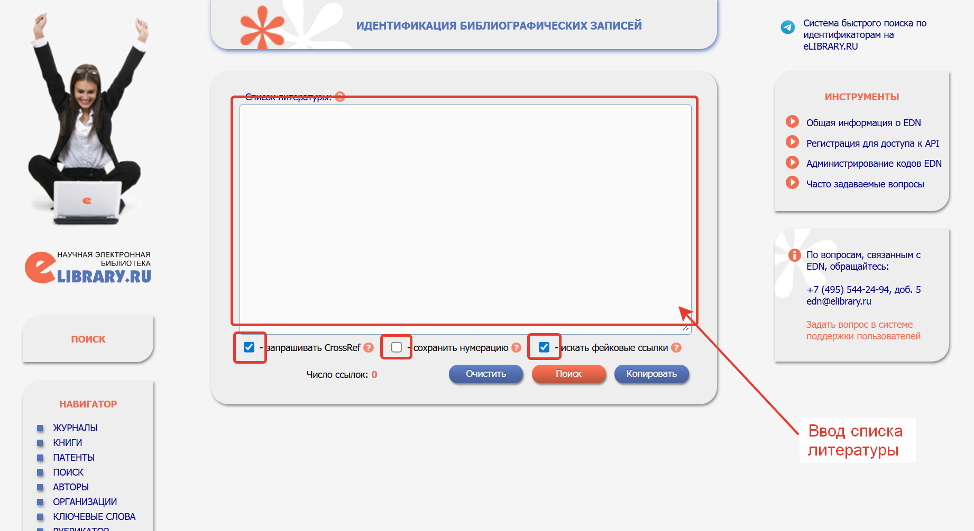

Slide 13
Check the boxes, upload the bibliography, and click “Search”

Slide 14
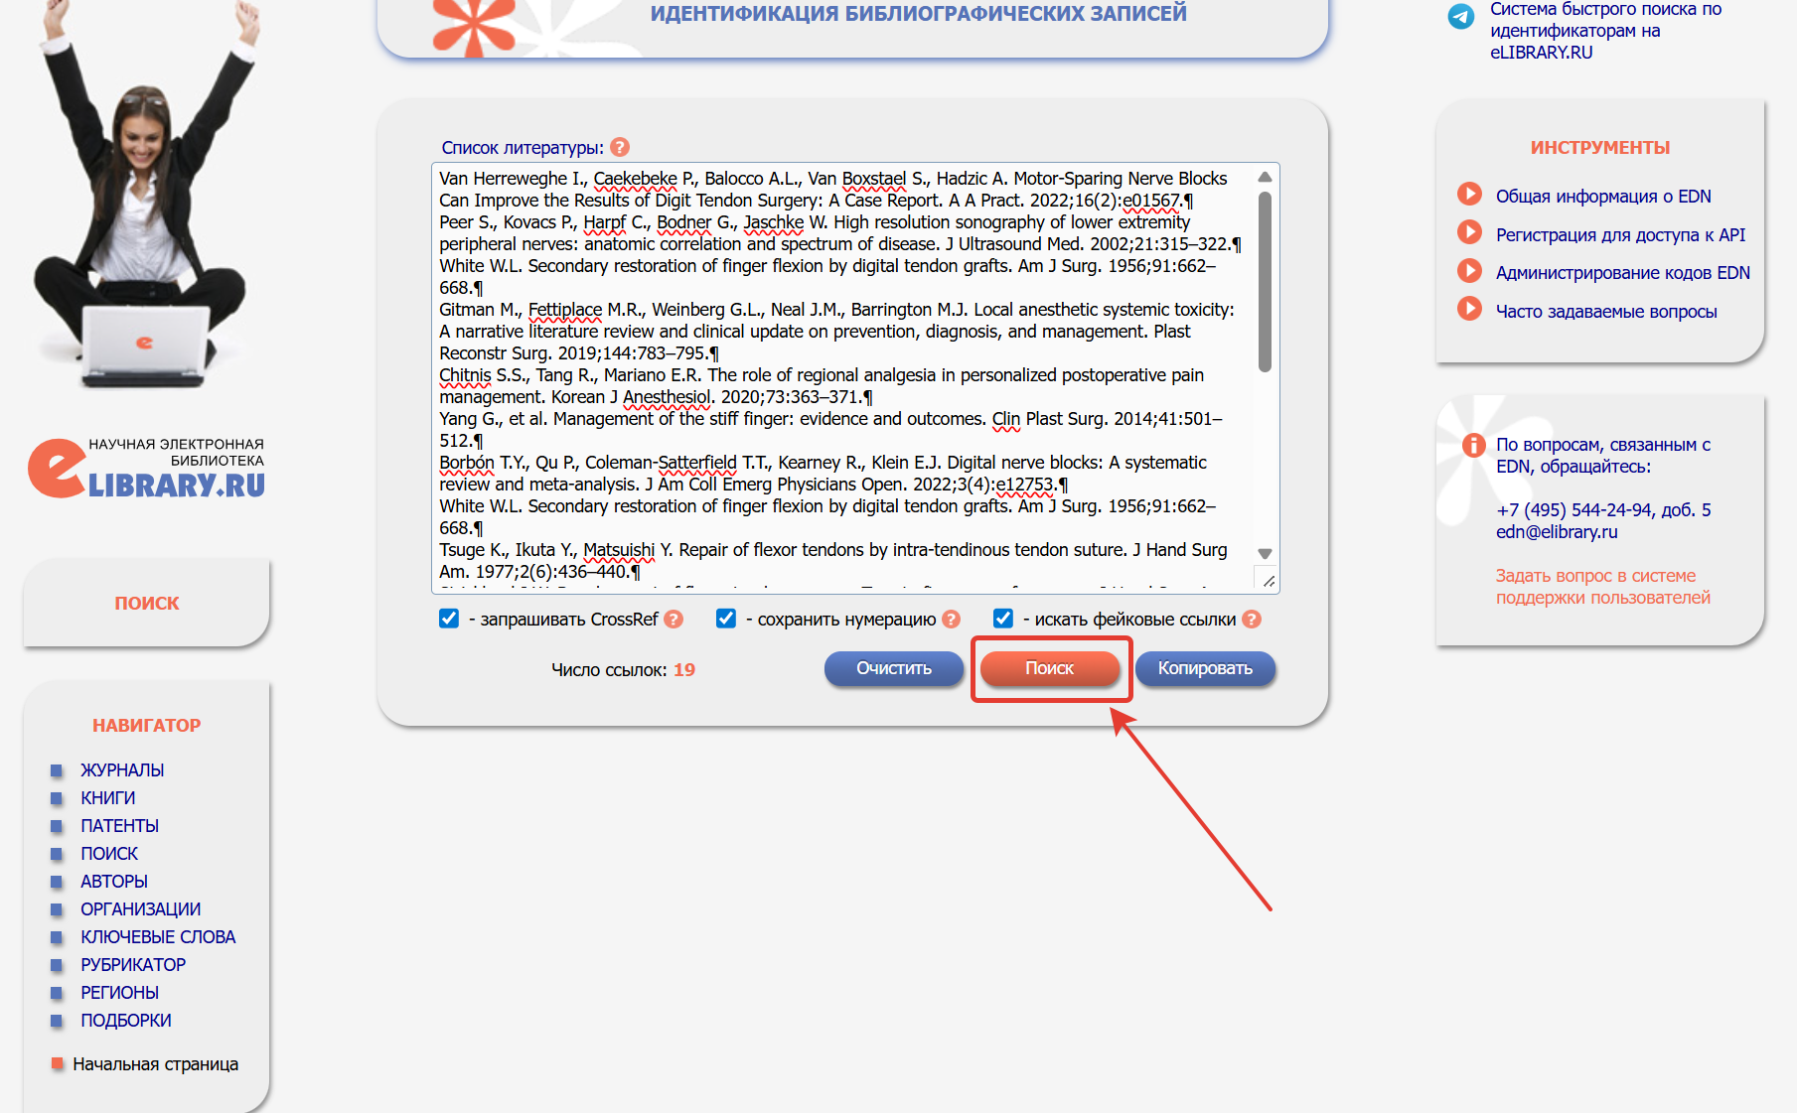

Slide 15
You get formatted output with active DOI and EDN links

Slide 16
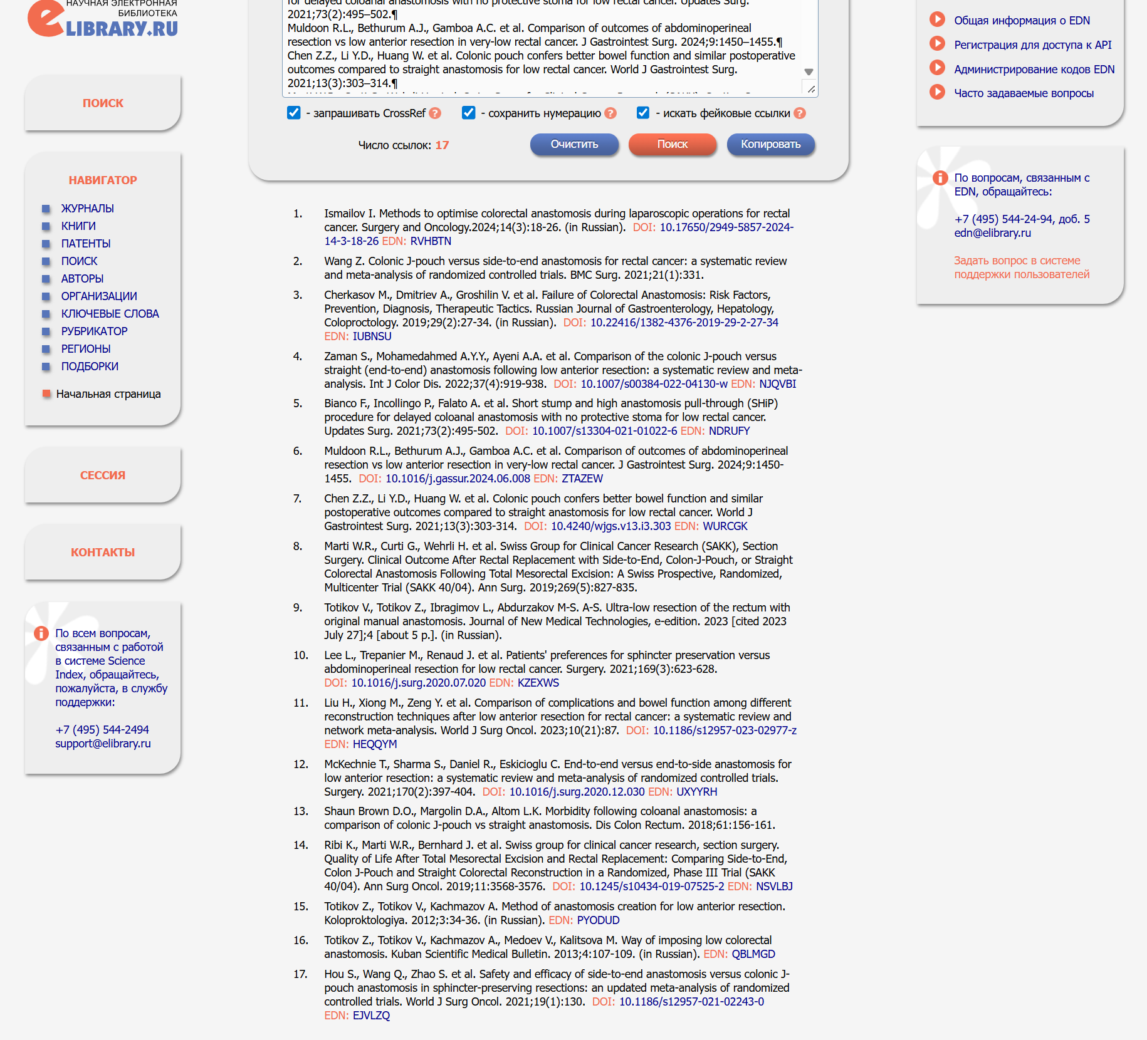

Slide 17
If available, copy the active DOI and EDN links to the clipboard: right-click and select “Copy link,” then, following your reference list’s format, paste the full link at the end of the citation after a space.

Slide 18
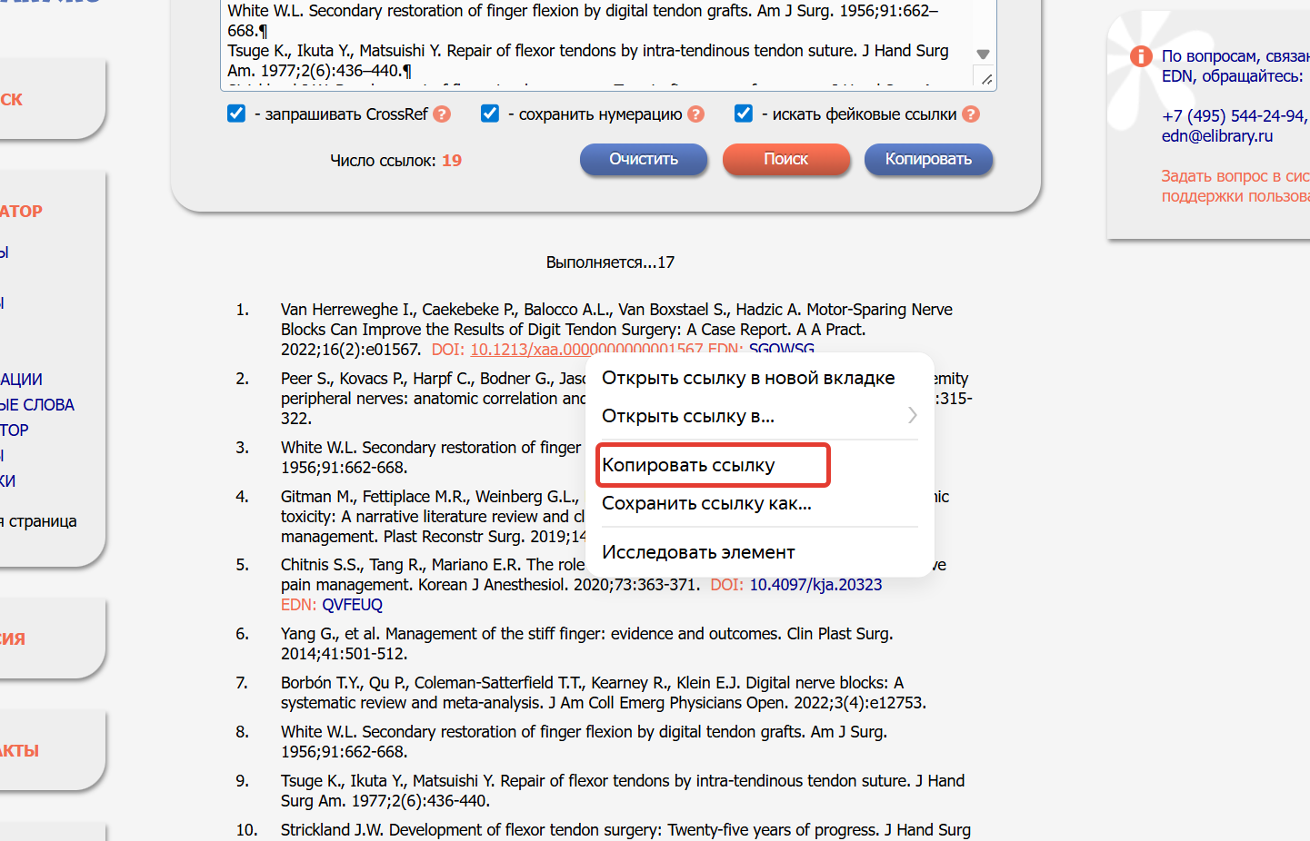

Slide 19
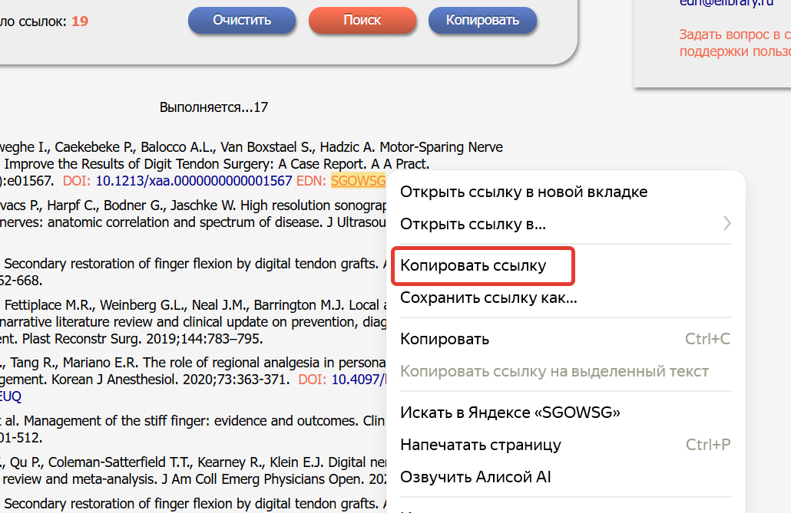

Slide 20
From a link like this:
Potekaev NN, Kisina VI, Romanova IV, Guschin AE, Polevschikova SA. Current status of Mycoplasma genitalium infection. Russian Journal of Clinical Dermatology and Venereology. 2018;17(3):12–21. (in Russian)

Slide 21
The following should be obtained:
Potekaev N.N., Kisina V.I., Romanova I.V., Guschin A.E., Polevschikova S.A. Current status of Mycoplasma genitalium infection. Russian Journal of Clinical Dermatology and Venereology. 2018; 17(3): 12-21. https://doi.org/10.17116/klinderma201817312 https://elibrary.ru/uvfdoq (in Russian).

Slide 22
Full links will allow interested readers easy access to the source directly from PDF files and digital copies of the article;

Slide 23
and, most importantly, when an article’s metadata is entered into reference databases, this will add significance to the article’s reference weight!

Slide 24
The article will appear complete and thorough, with cited sources fully integrated.

Slide 25
If, for whatever reason, the eLIBRARY service is unable to identify a literature source and there are no active DOI or EDN links, it is easy to find the missing information using search engines such as Yandex, Google, etc.

Slide 26
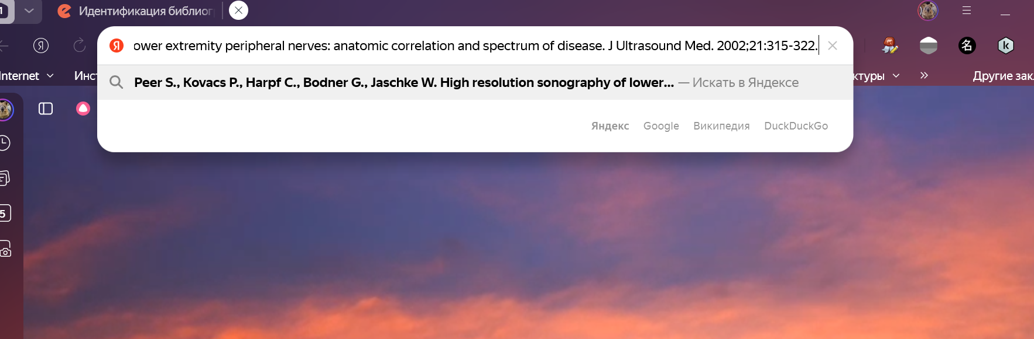

Slide 27
Copy the source and paste it into the search bar…

Slide 28
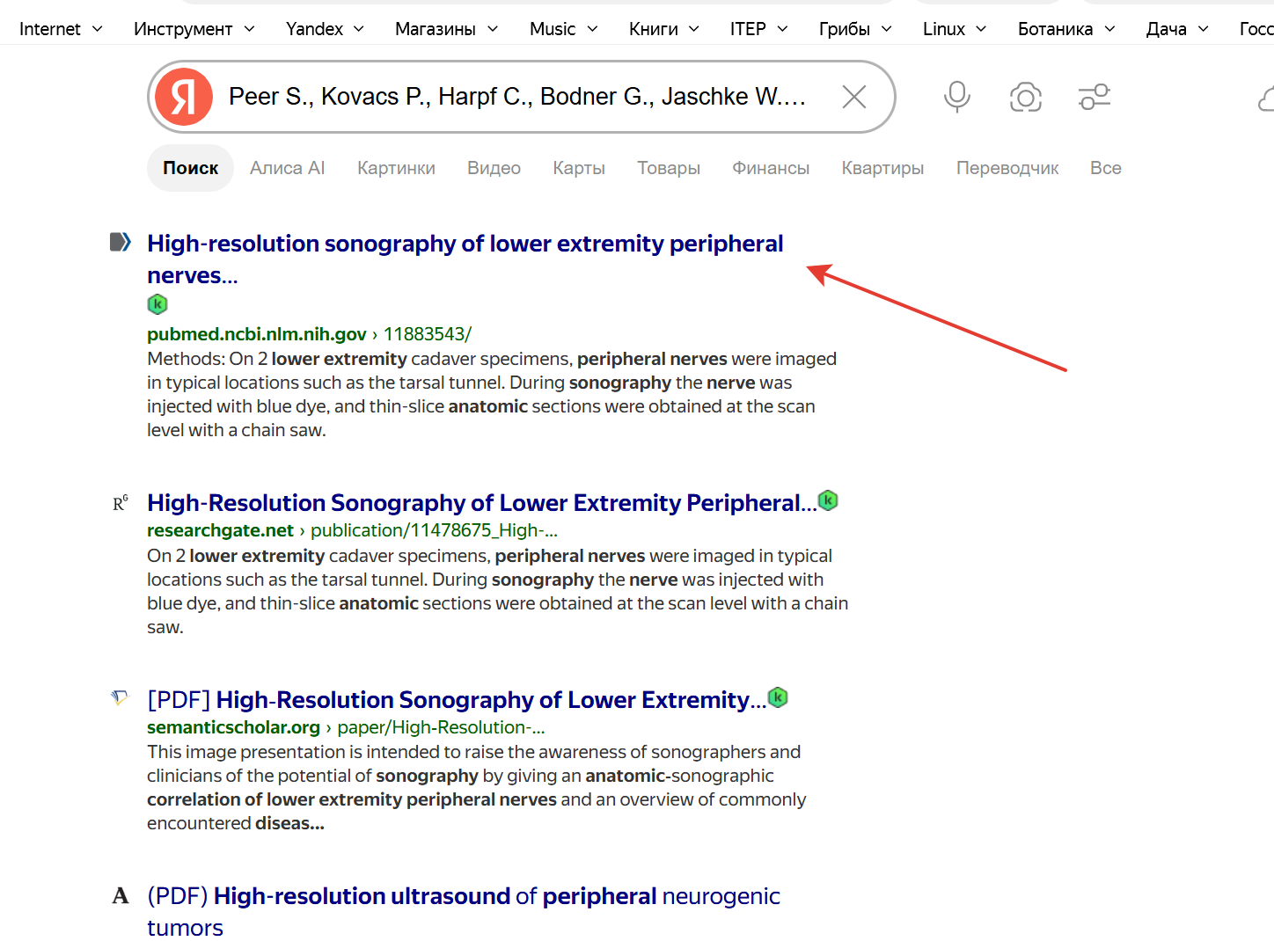

Slide 29
When we get the output, we go to the source’s location, verify that the list of authors, title, and other metadata are correct, and copy the DOI link.

Slide 30
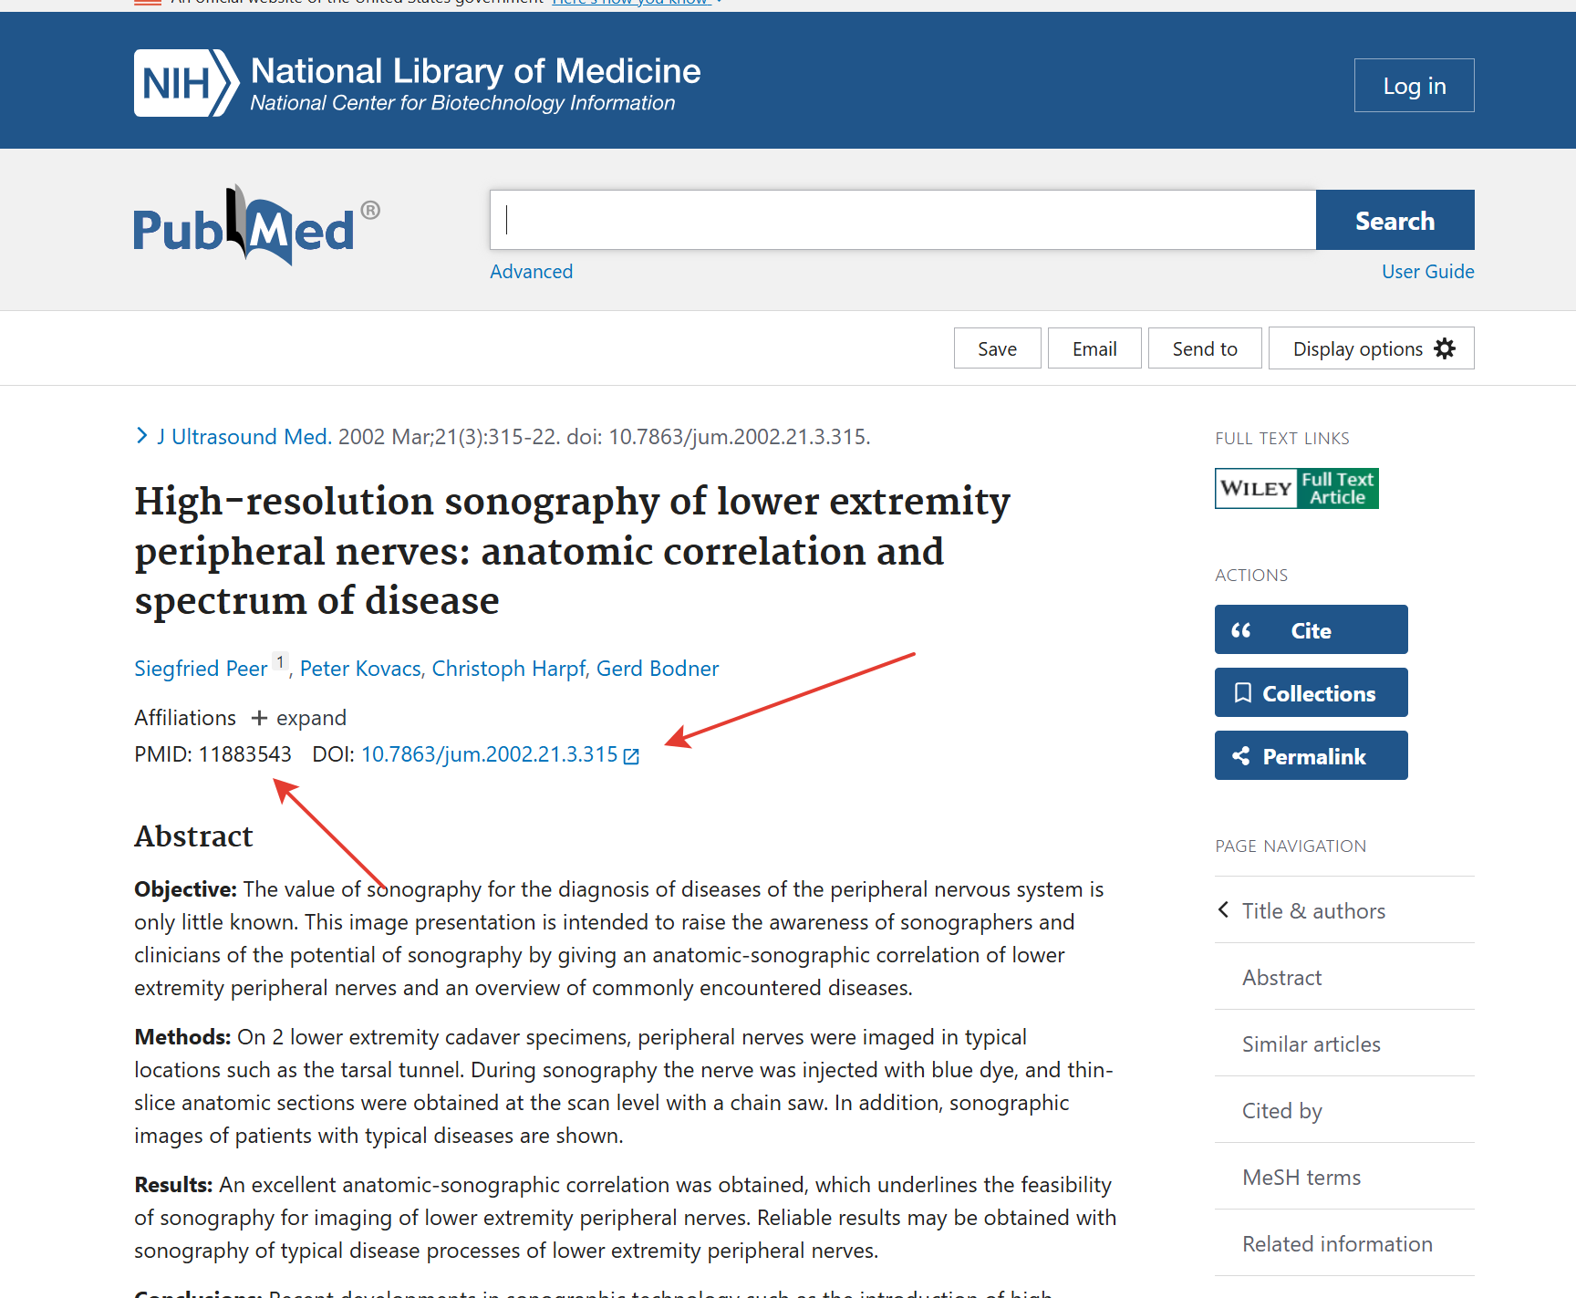

Slide 31
Optionally, we can specify a PubMed identifier, e.g., PMID: 12345678

Slide 32
The following are not permitted in the reference lists: 1. To double references: in this case, you should revise the reference list and the numbering of references in the text of the article.

Slide 33
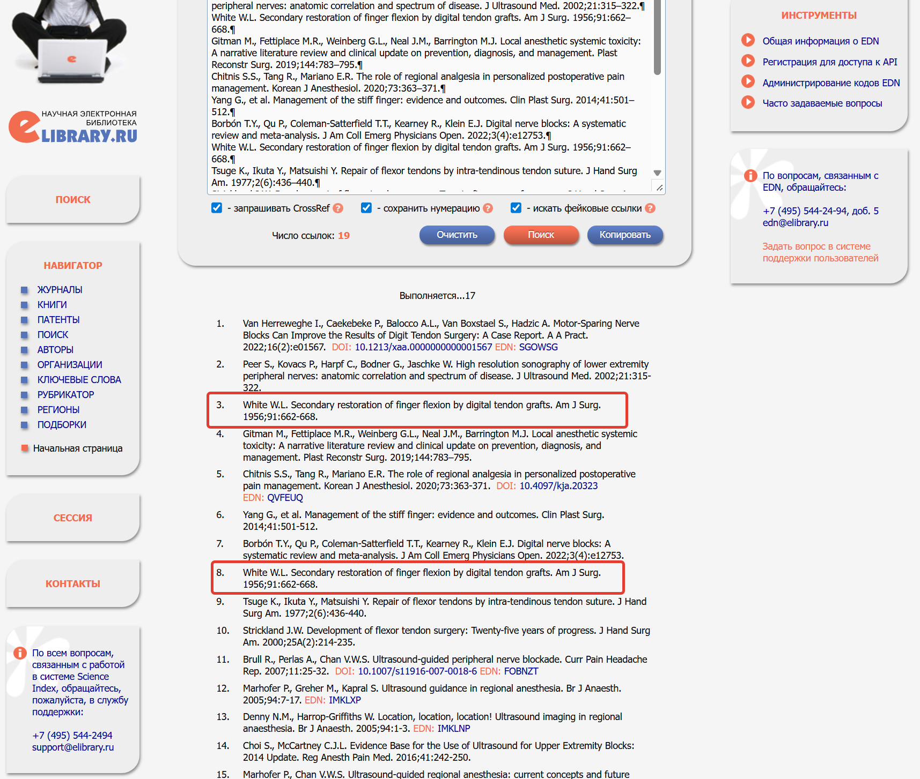

Slide 34
2. Invented and/or generated links marked with an exclamation mark in the search results. If a question mark appears, the link should be carefully checked.

Slide 35
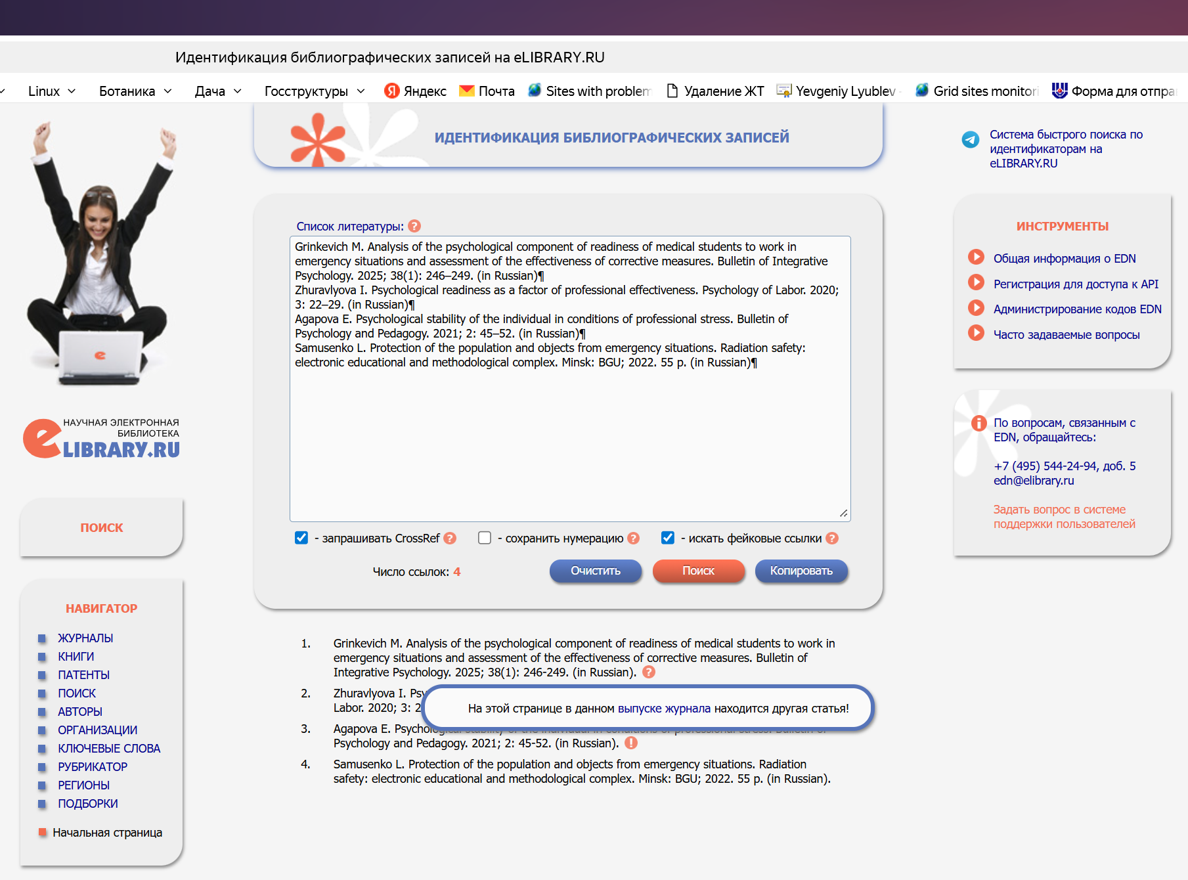

Slide 36
Invented and/or generated links are indicators of falsification and demonstrate that the written article has zero scientific merit. Detecting such articles in abstract databases casts the author in a negative light and harms the Publisher's reputation!

Slide 37
We wish all Authors to create honest, high-quality research papers, and to increase their citation index!

